Slide 1

Realistic Image Generation
Scientific Computing Department
Faculty Of Computer & Information Science
Ain Shams University

Slide 2
Under Supervision
Dr.Manal Mohsen Tantawy
TA. Radwa Reda Hoseny
Team members
Ahmed Shaaban Abdo Hassan
Ammar Yasser Mahmoud Saad
Ehab Mohamed Abd Elmonem
MennatAllah Wael Saed
Mohamed Hesham Eldesouky
Nada Mohamed Taalab Abdullah

Slide 3
Agenda
01
02
03
04
05
06
08
09
System Architecture
Datasets &Implemented Techniques
Introduction
Related Work
07
Experimental Results
Demo
Tools
Conclusions
Future Work

Slide 4
Problem Definition

Slide 5
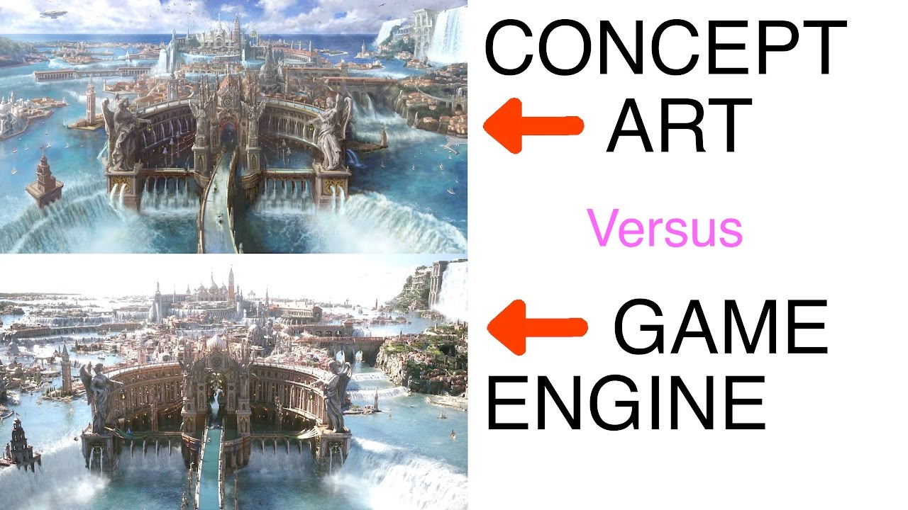
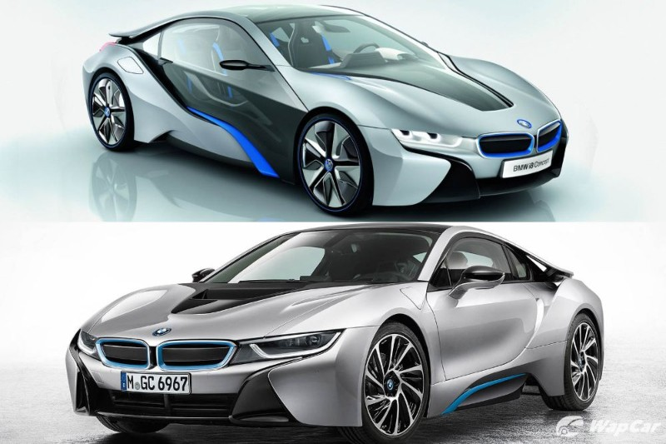
Problem Definition
Designing an object or a product has always been a time and resources consuming task, it can take from weeks to months to design a concept which is too challenging in our rapidly growing world
Getting rid of the concept designing process will not help as this will lead to developing a product that won’t satisfy the requirements which is the main focus in developing product

Slide 6
Motivation

Slide 7
Motivation
Saving time and effort taken by designers to design a concept art, for industry, saving cost of products and speeding up the production process
According to TrueList, the rate of increase in designing field is expected to grow by 3% by the year 2030
Recently, new technologies are developed, but there are not much researches made for them and no clear approvals, that can be used to solve such a problem

Slide 8
Objective

Slide 9
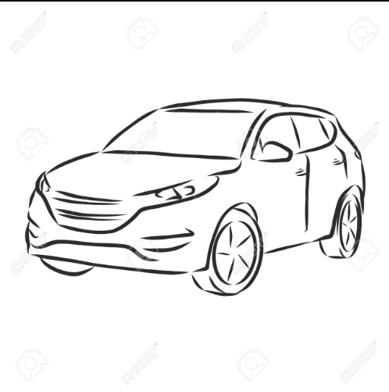
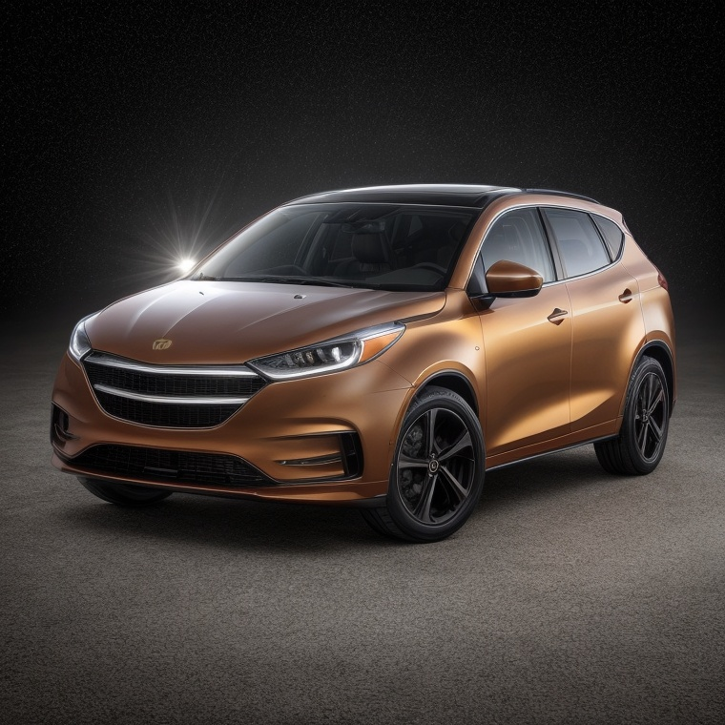
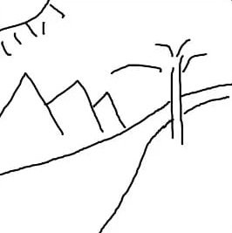

Objective
Project’s goal is to develop a system that generates images from hand sketches using deep learning to make the process of concepts designing faster and less cost

Slide 10
02
Related Work

Slide 11
Related Work
Author | Dataset | Preprocessing | Model | Evaluation
Runtao Liu [1] [2020] | ShoeV2 ChairV2 | Resized | 2-stage model | FID = 48.73
Subhadeep Koley et al. [2] [2023] | ShoeV2 Handbags ChairV2 | Colorization Inpainting Enhancements Style-transfer Simple Arithmetic Operations | StyleGAN | FID=35.85 FID=100.23 FID=90.21
Ankan Kumar Bhunia et al. [3] [2022] | Creative Birds Creative creatures | Resizing Normalization | Doodler Former | FID =16.45 FID =18.71
Yunji Kim et al. [4] [2023] | MS-COCO | - | Dense Diffusion | SOAI: 77.61

Slide 12
Related Work cont.
Author | Dataset | Preprocessing | Model | Evaluation
Wenjing Huang et al. [5] [2023] | COCO-Animals | Augmentation Sampling Encoding Adding Noise | PFB | FID: 6.259
Muyang Li et al. [6] [2021] | Edges2shoes Edges2 Handbags | Resizing Converting to arrays Normalization | Conditional GAN | FID =96.514 FID =130.325
Yongyi Lu [7] [2018] | CelebA CUB-200 Stanford's Cars | XDoG Photocopy simplified | Contextual GAN | Accuracy = 99.8

Slide 13
Comments on survey
The most common architectures for this task are GANs.
GANs are much limited to specific domains which gives advantage to Diffusion Models.
Diffusion Models are more generalized which makes them suitable for non-domain-specific problems.
Fréchet inception distance (FID score) score is the common measurement.
Normalization and Resizing are necessary preprocessing steps.

Slide 14
03
System Architecture

Slide 15
Generative Model
Preprocessing
System Architecture
1
2
3
4

Slide 16
04
Datasets &Implemented Techniques

Slide 17
Common Datasets
Name | QuickDraw | SketchyCOCO (single object version)
Size | 50M sketches | 20K triplets (image - sketch - edge map)
Categories | 345 categories | 14 categories
Comments | single object sketches labeled with names | Sketches didn’t describe the object in the real image. The images are badly segmented

Slide 18
Datasets
Challenge:
The single object version of SketchyCOCO had sketches that don’t describe the shape and pose of the real image and the real image was a badly cropped version on a white background of the scene images which destroyed the images.
Solution: Collect a Custom Dataset

Slide 19
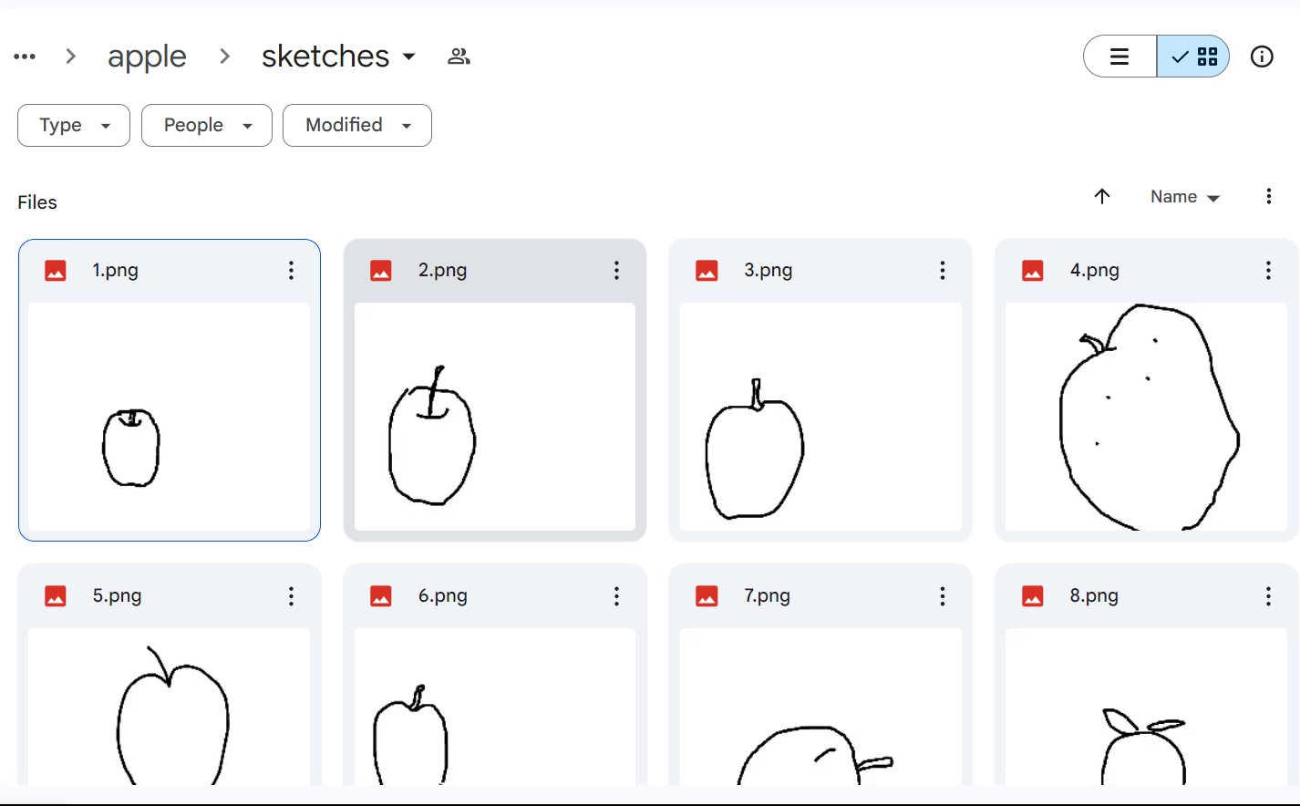
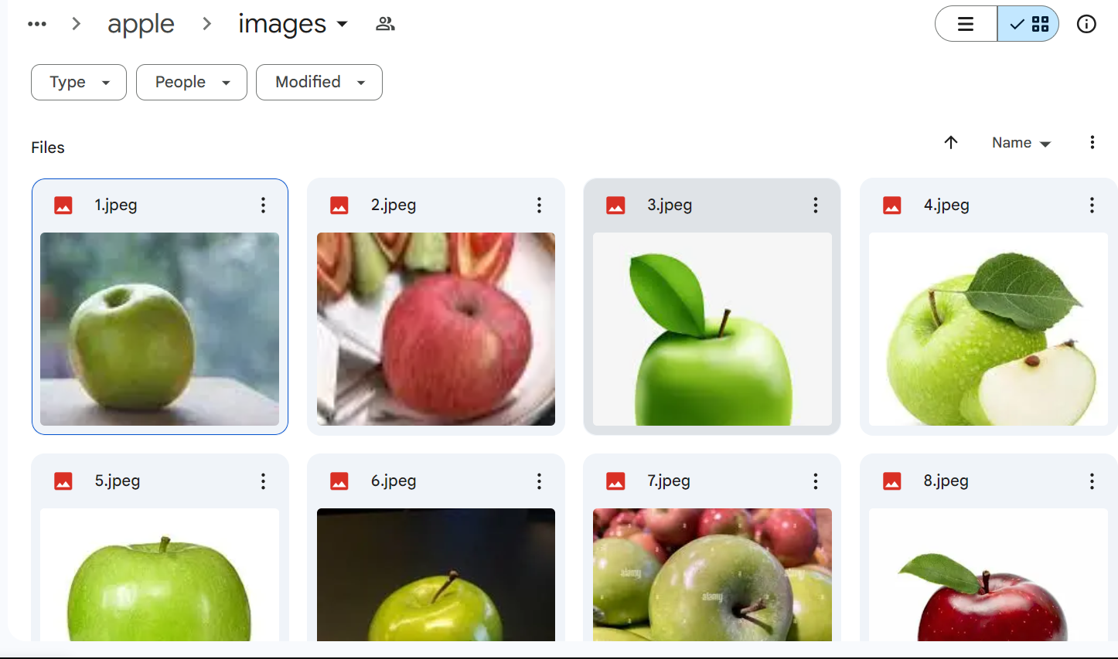
Collected Dataset
Real Images were collected from 3 different public datasets.
corresponding sketches were collected from QuickDraw dataset
11 classes each class containing 20 pairs of images and their corresponding sketches.

Slide 20
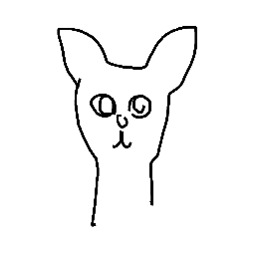
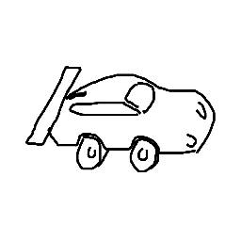
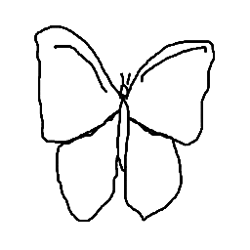
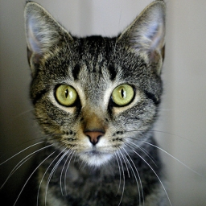
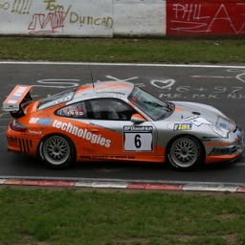
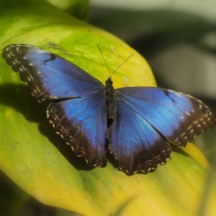
Selected Datasets: Sketchy
The dataset includes 125 classes of images and their corresponding sketches.
Each class has 100 images of single object in scene
Each image has average of 4 sketches describing the object in the image.
3 classes were selected from sketchy dataset
(butterfly, car, cat)

Slide 21

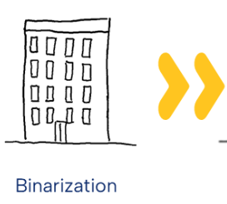
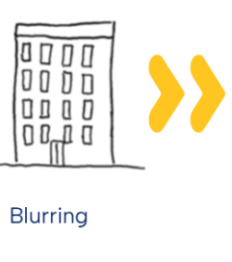
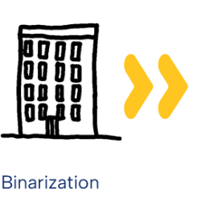
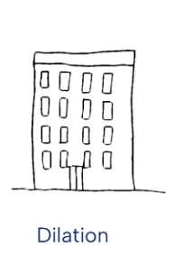
Preprocessing
It is not mentioned as a step when using our selected dataset, so we did the following as enhancement steps:
Resized to 500 x 500
Binarization
Blurring with kernel size 13 x 13
Binarization
Dilation with kernel size 13 x 13

Slide 22
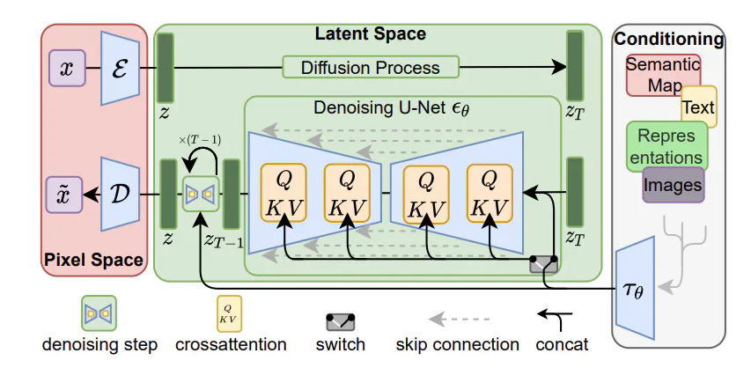
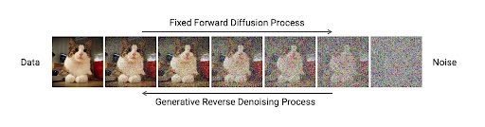
Algorithms: Diffusion Models
The corresponding image is encoded using a condition encoder, denoised by a U-Net denoiser, then decoded using an image decoder.

Slide 23
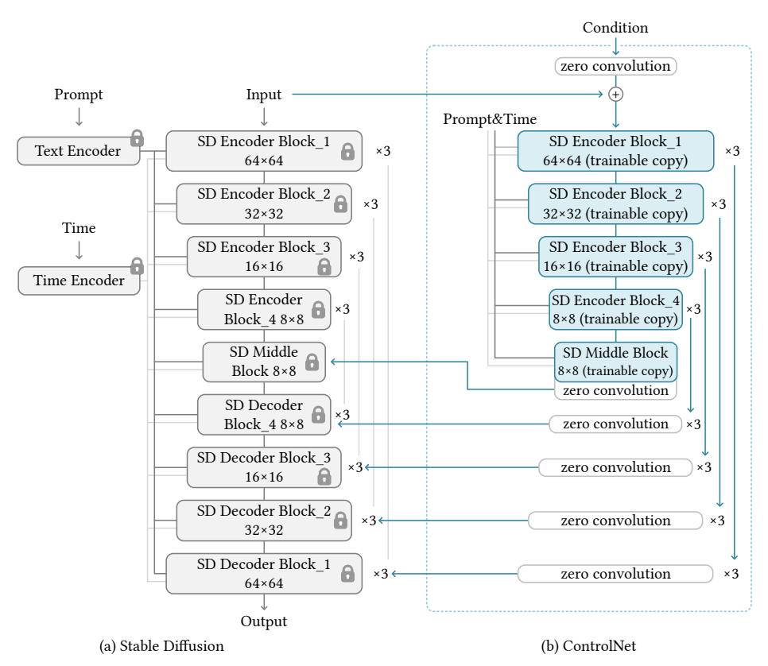
Algorithms: ControlNet
ControlNet is a neural network structure that controls diffusion models by adding extra conditions. It duplicates the weights of neural network blocks into a “locked” copy and a “trainable” copy.

Slide 24
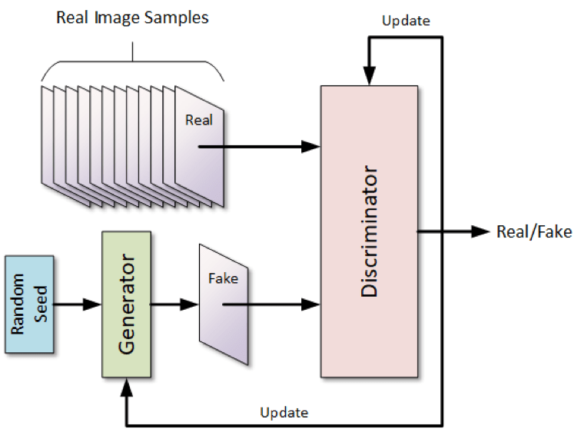
Algorithms: GANs
Basically, a Generative Adversarial Network consists of two parts pitting against each other i.e. the Discriminator and the Generator. The generator takes the role of a forger and learns to map from a latent space to a particular data distribution of interest.

Slide 25
Algorithms: GANs Types
Vanilla GAN: generate data based on random seed (non-deterministic)
Conditional GAN: generate data based on guidance (deterministic)
Super-resolution GAN: increase the resolution of the data
CycleGAN: maps data from variation to other variation

Slide 26
Algorithms: Conditional GAN
Random seed generation will result in random output
Conditional GAN accepts a condition input that works as guidance that generates data with specifics
This is benefitical in case there are variations in the data
In Vanilla GANs generation process is domain specific or the output data can’t be predicted

Slide 27
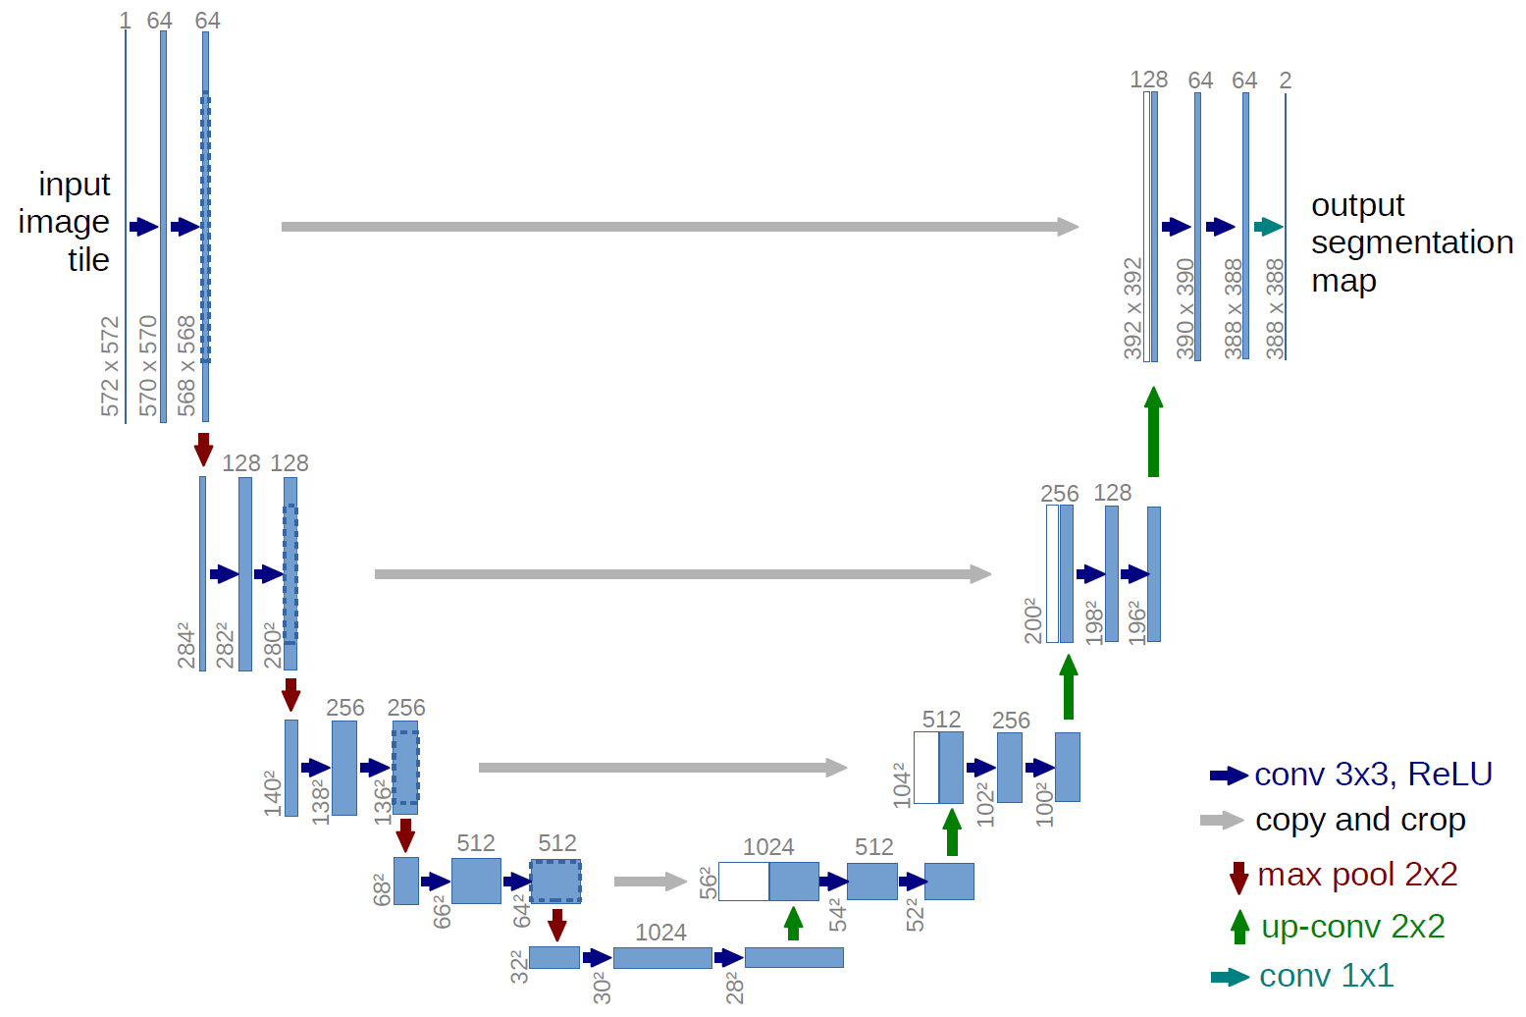
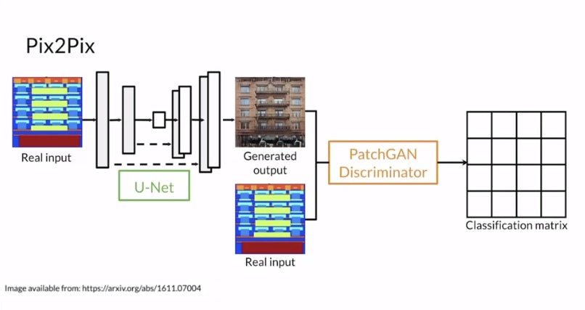
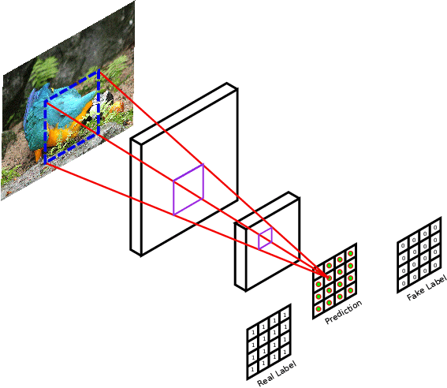
Algorithms: pix2pix
A CGAN conditioned on images is called pix2pix
In this model we can generate images based on condition in image representation
Condition can be segmentation map, edge detection, or sketches (our case)

Slide 28
Algorithms: pix2pix finetuning
We first trained the model for 50 epochs on canny edge detection as a strong constraint from images of 3 classes (butterfly, car, cat)
Then the model was finetuned for 150 more epochs on sketches as a waek constraint
This gives the model better generation ability than directly training it on sketches
Results of these experiments will be discussed in the next section

Slide 29
05
Experimental Results

Slide 30
Evaluation Criteria
Fréchet Inception Distance (FID)
Evaluation method of the quality of generated images from any deep learning models as: GAN, etc.
It provide a more robust measure of the quality of generated images by comparing statistics (mean and covariance) of features extracted from real and generated images.
FID provides a numerical score that indicates the realism of the generated images, with lower scores suggesting higher quality.

Slide 31
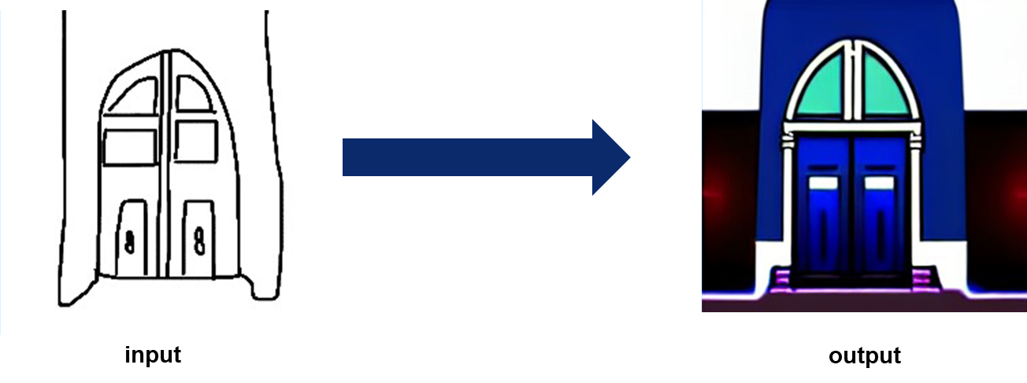
ControlNet Results
Model Name | No. of epochs | FID
ControlNet | 10 | 7996.29
 | 20 | 6487.25
 | 30 | 7550.70

Slide 32
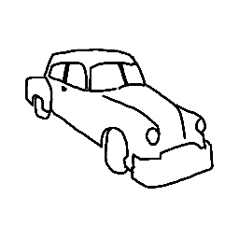
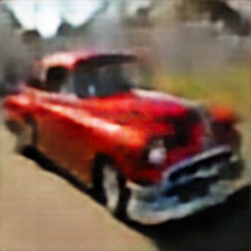
CGAN Results
Model Name | No. of epochs | FID
CGAN | 50 | 131.04
 | 100 | 131.77
 | 150 | 55.02

Slide 33
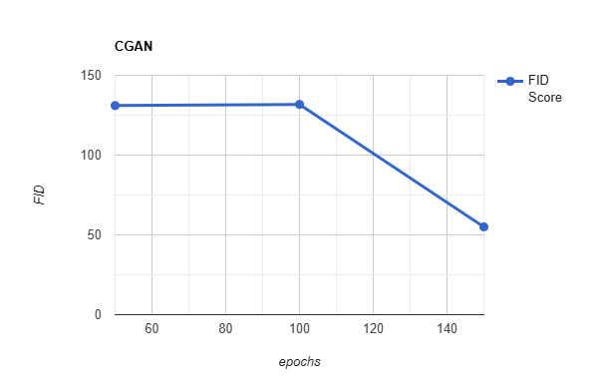
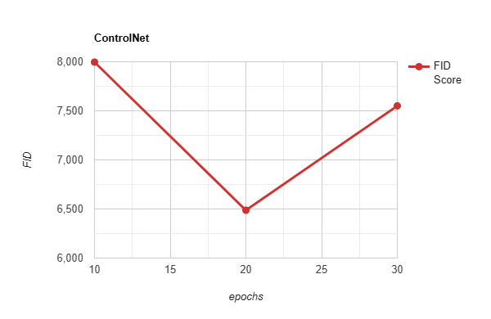
Summarized Results

Slide 34
06
Demo

Slide 35
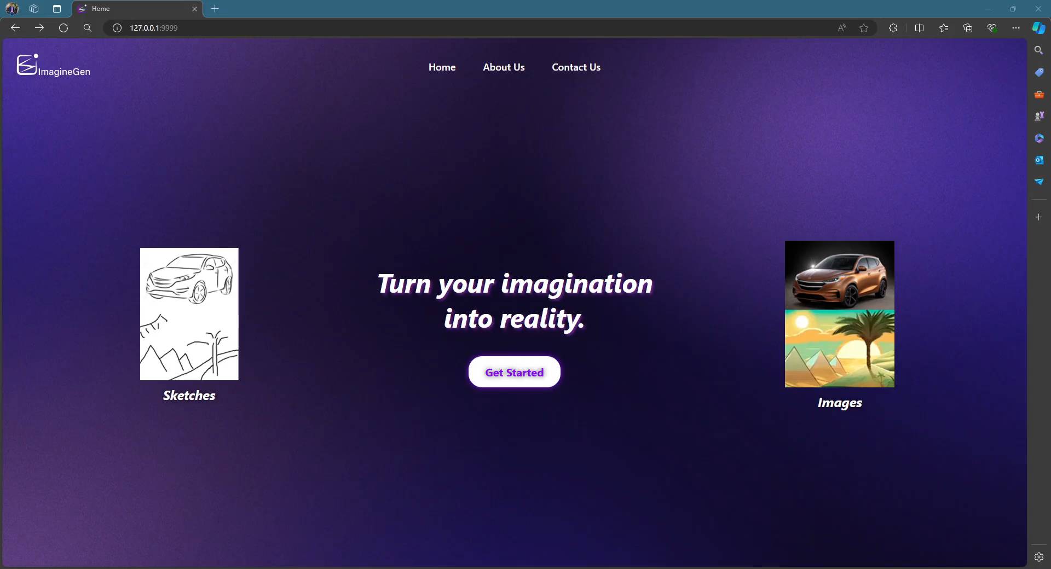
Generating from new sketch

Slide 36
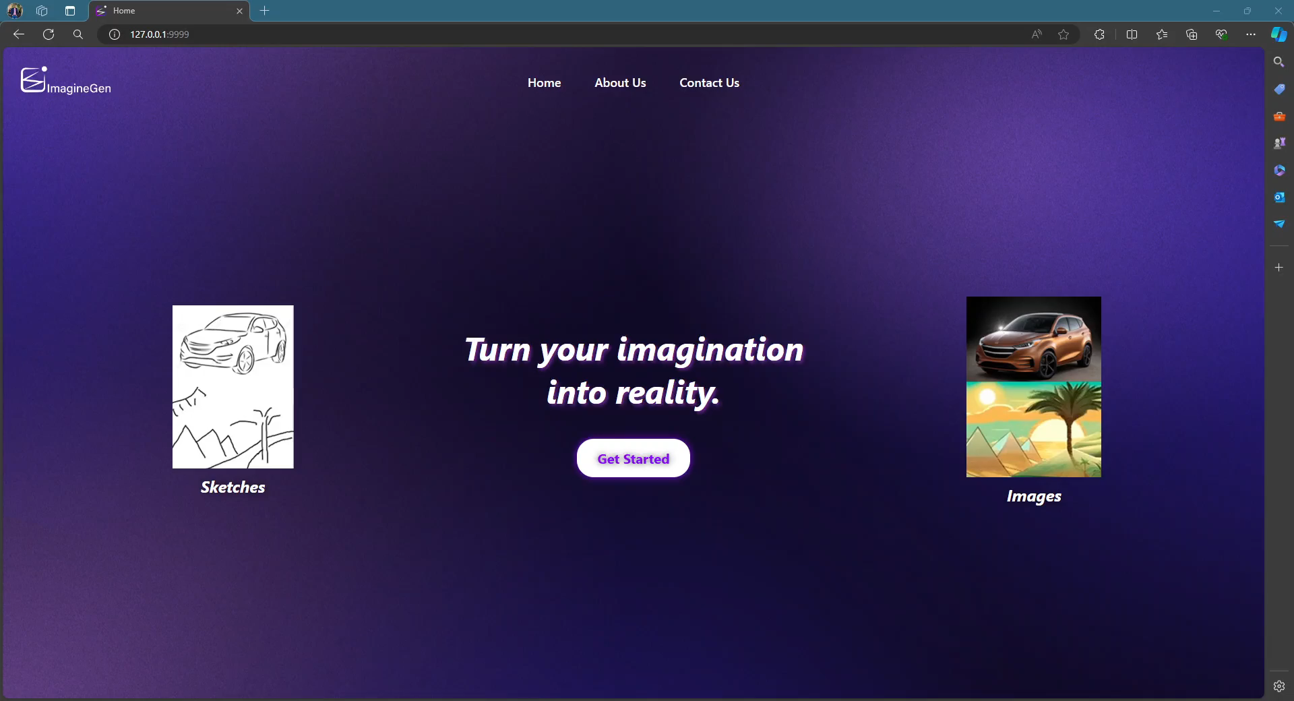
Uploading a sketch

Slide 37
07
Tools

Slide 38






Tools
Python
Colab
Kaggle
PyTorch
Flask
HTML, CSS, JS

Slide 39
08
Conclusions

Slide 40
Conclusions
Project challengeable target was achieved to generate image from only sketch without any text.
The challenge of dataset solved by collected dataset and Sketchy dataset.
Two main methodologies are explored: Diffusion Models and Generative Adversarial Networks (GANs).
The best result was achieved with FID= 55.02 by CGAN
User Interface was applied with high acceptability with different options (upload or draw sketch, use select model)

Slide 41
09
Future Work

Slide 42
Future Work
Different Advanced models can be appeared that’s more suitable for generation.
This application can be used in domain adaption where the used model can be finetuned on dataset of specific domain
Advanced technologies in the future can be used to generate multiple objects in the same scene.

Slide 43
References

Slide 44
References
Runtao Liu, Qian Yu, and Stella Yu - Unsupervised Sketch-to-Photo Synthesis - Peking University (2020)
Subhadeep Koley, Ayan Kumar Bhunia, Aneeshan Sain - Picture that Sketch: Photorealistic Image Generation from Abstract Sketches - University of Surrey, United Kingdom (2023)
Li Liu, Fumin Shen, Yuming Shen Xianglong Liu - Deep Sketch Hashing - University of Electronic Science and Technology of China (2017)
Yunji Kim, Jiyoung Lee, Jin-Hwa Kim, Jung-Woo Ha, Jun-Yan Zhu - Dense Text-to-Image Generation with Attention Modulation - Carnegie Mellon University (2023)
Wenjing Huang, Shikui Tu, Lei Xu - PFB-Diff: Progressive Feature Blending Diffusion for Text-driven Image Editing - Shanghai Jiao Tong University (2023)
Muyang Li, Ji Lin, Yaoyao Ding, Zhijian Liu, Jun-Yan Zhu and Song Han - GAN Compression: Efficient Architectures for Interactive Conditional GANs - IEEE (2021)
Yongyi Lu ,Shangzhe Wu,Yu-Wing Tai - Sketch Constraint Using Contextual GAN - University of Oxford (2018)

Slide 45
Thanks
Do you have any questions?

